Slide 1



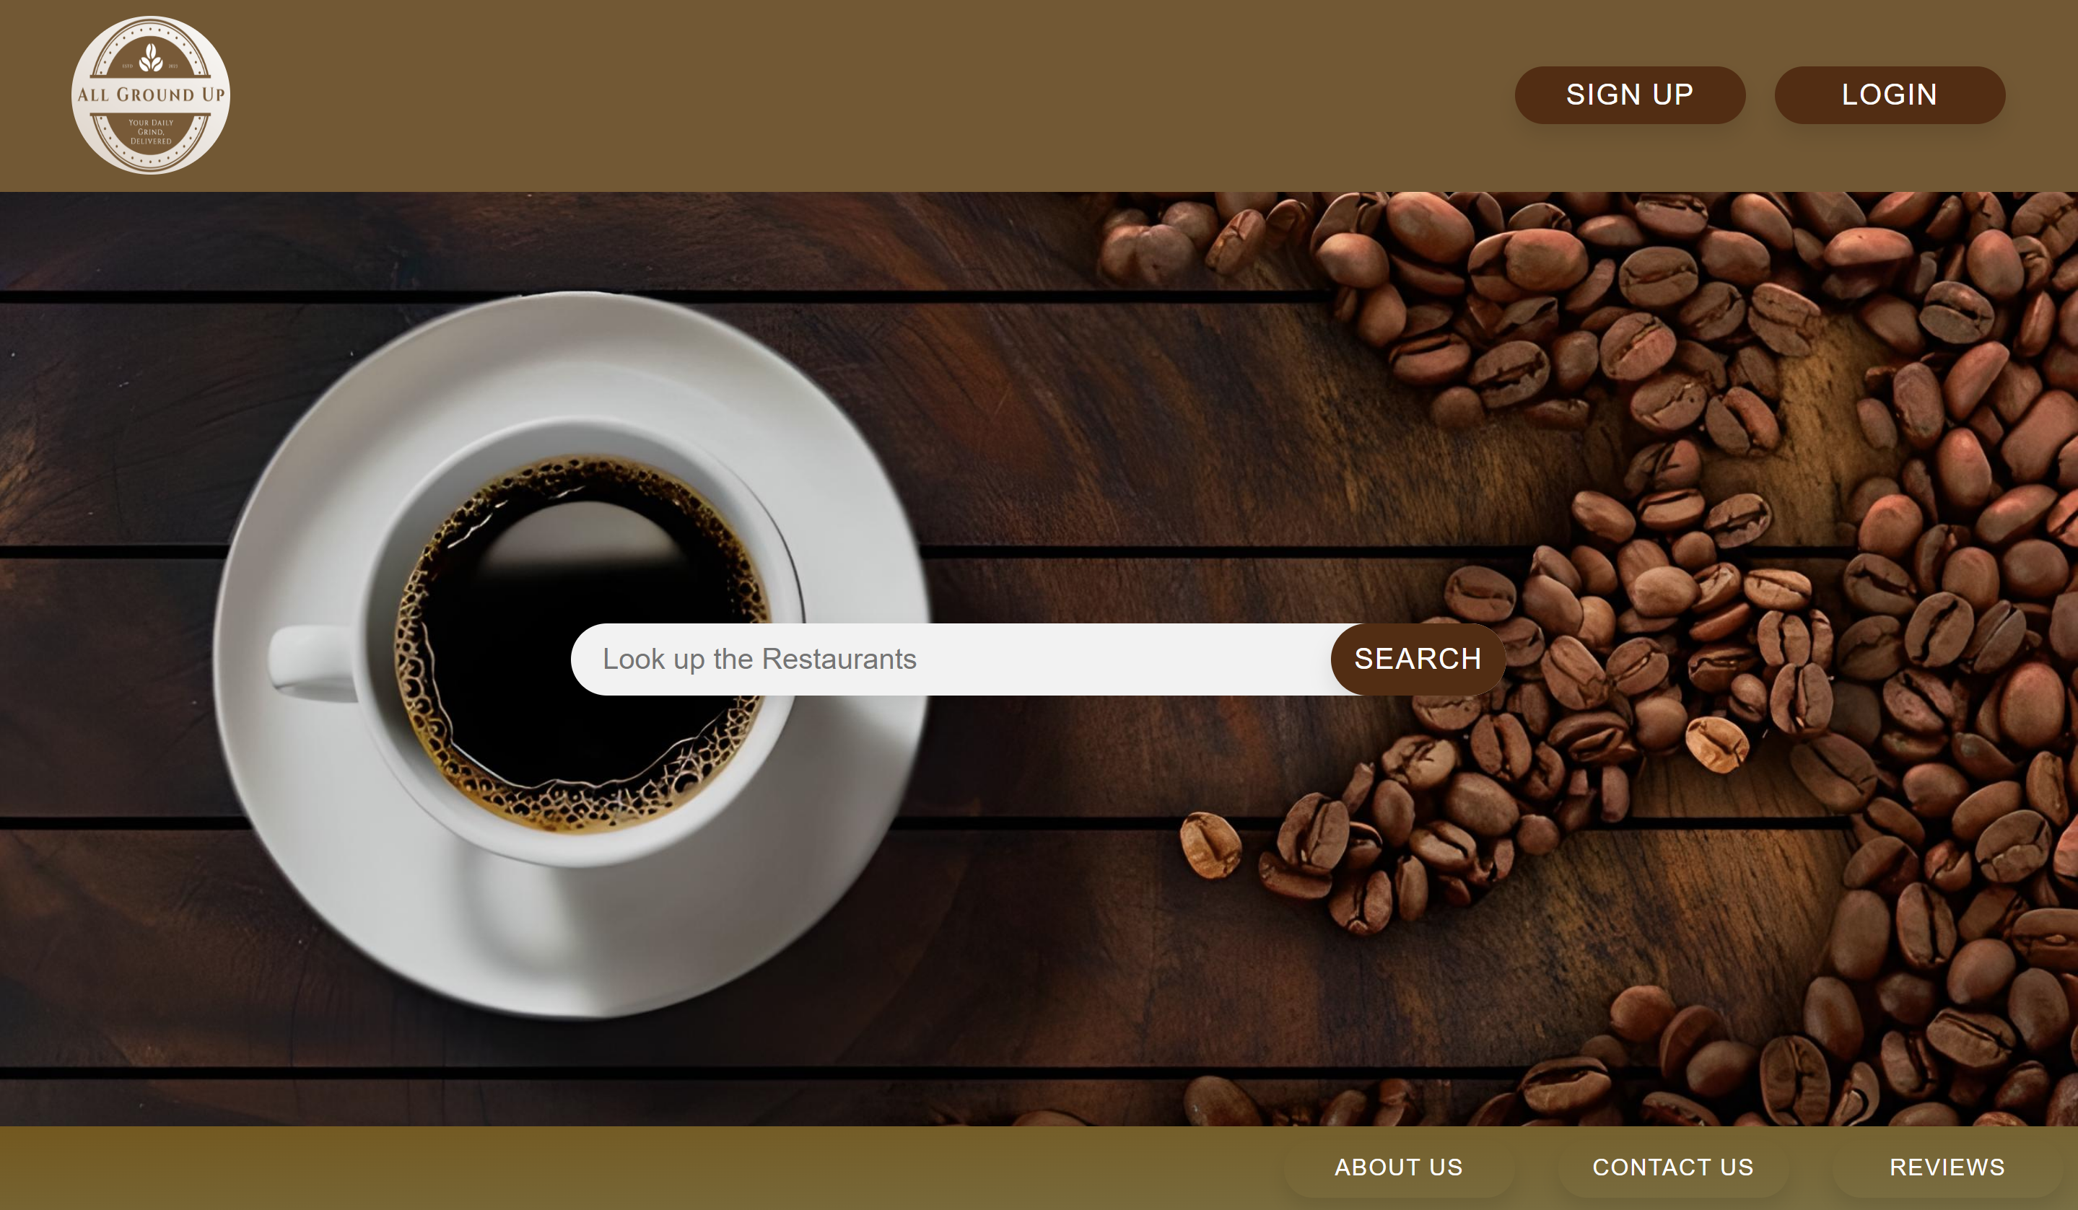
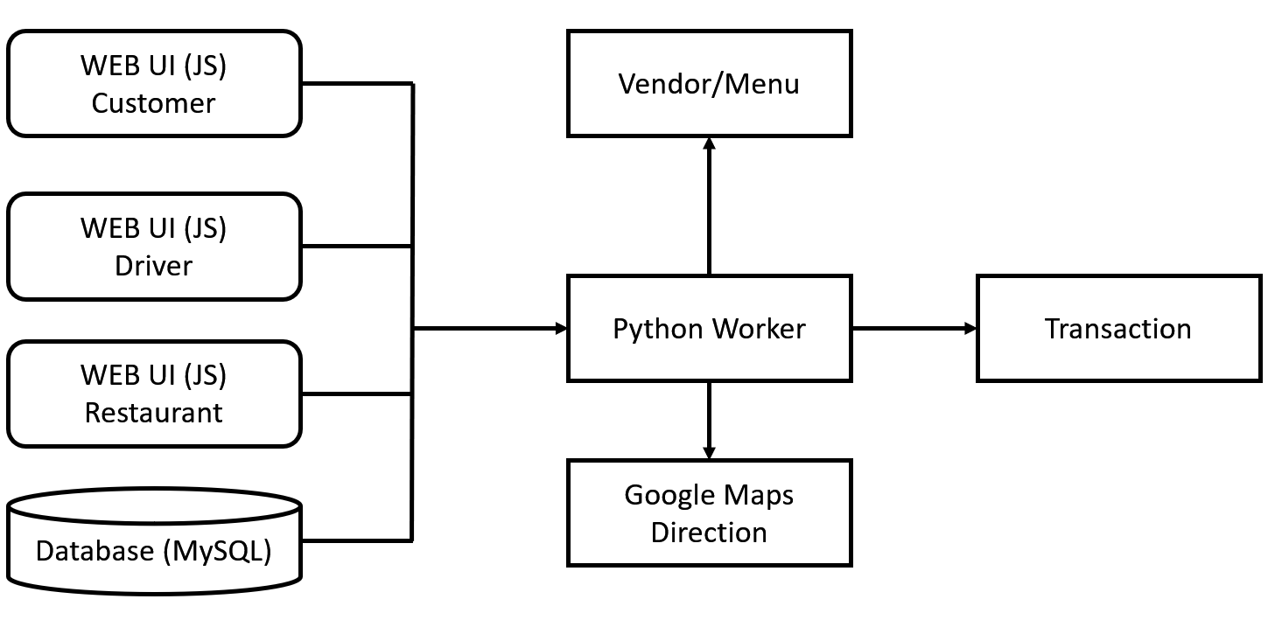
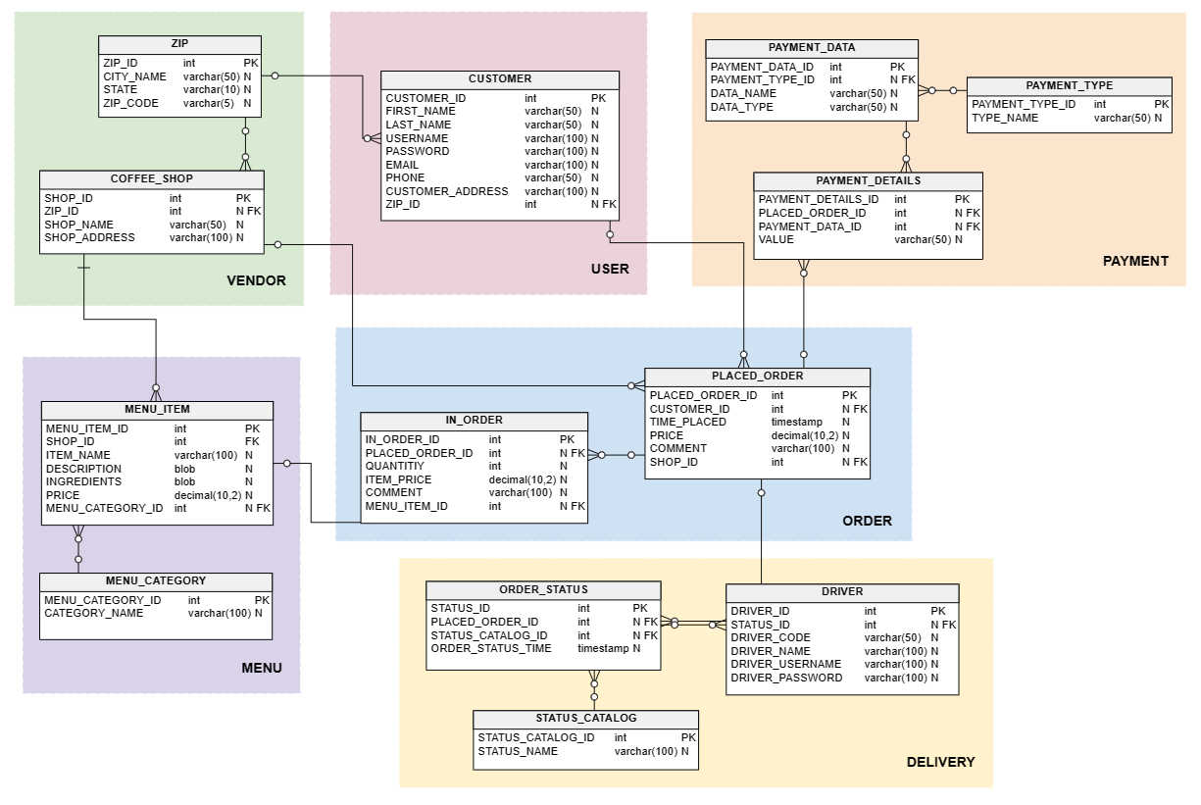
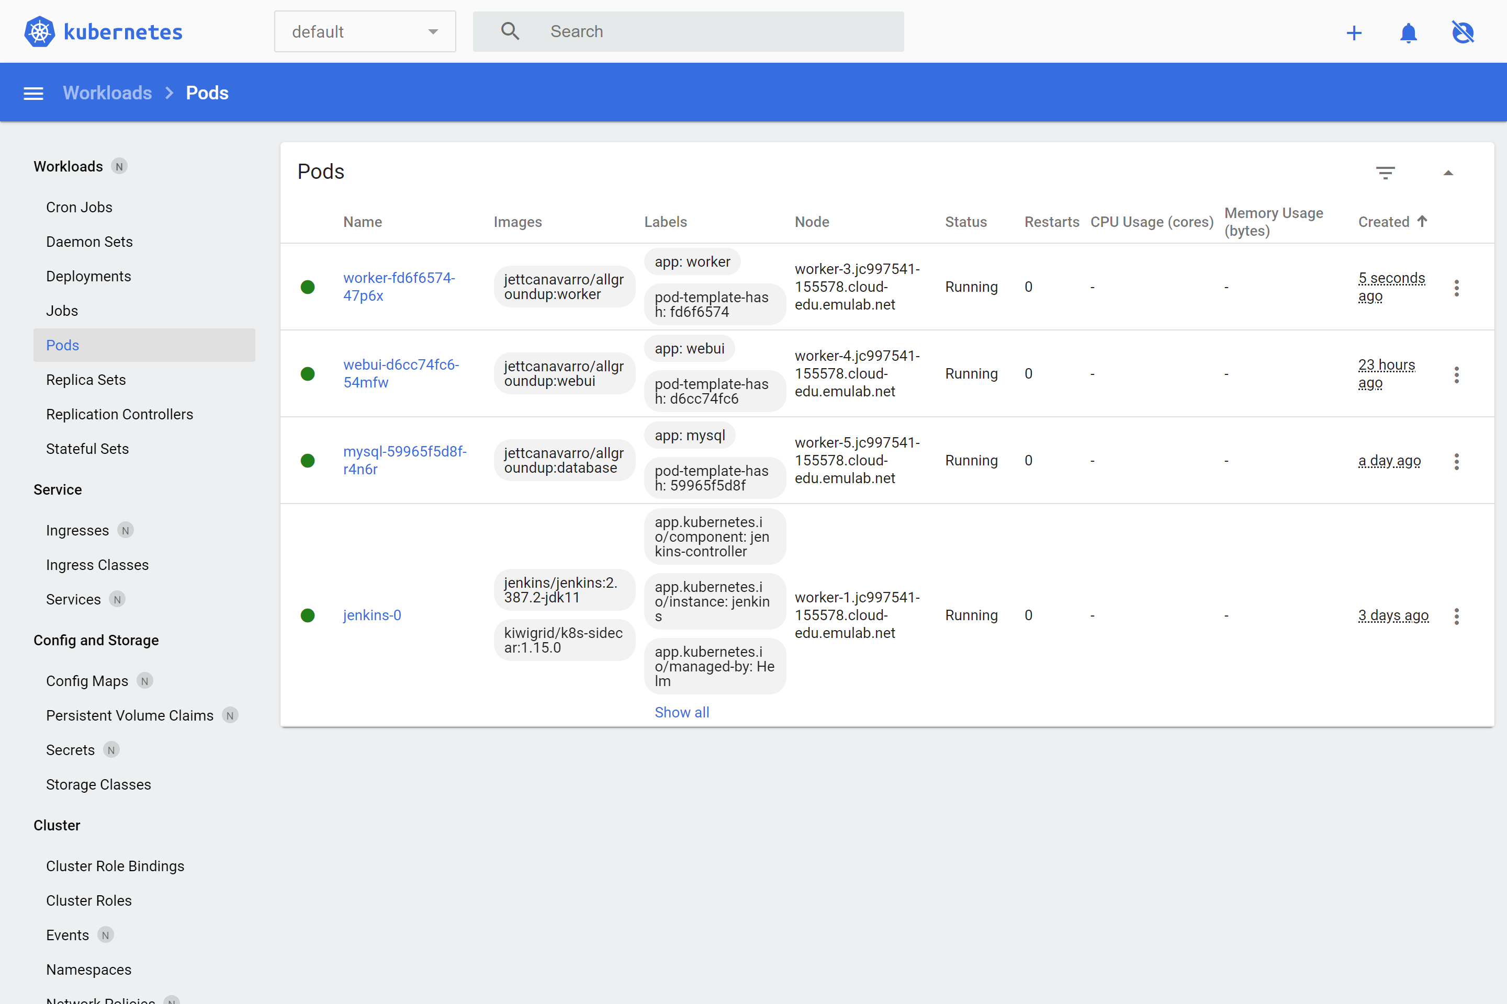
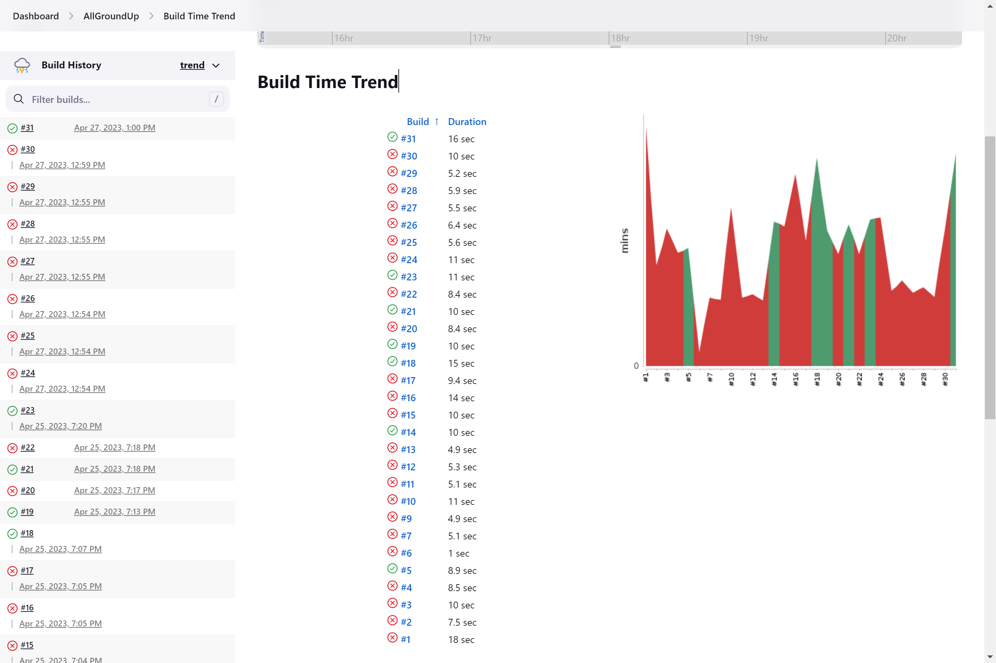
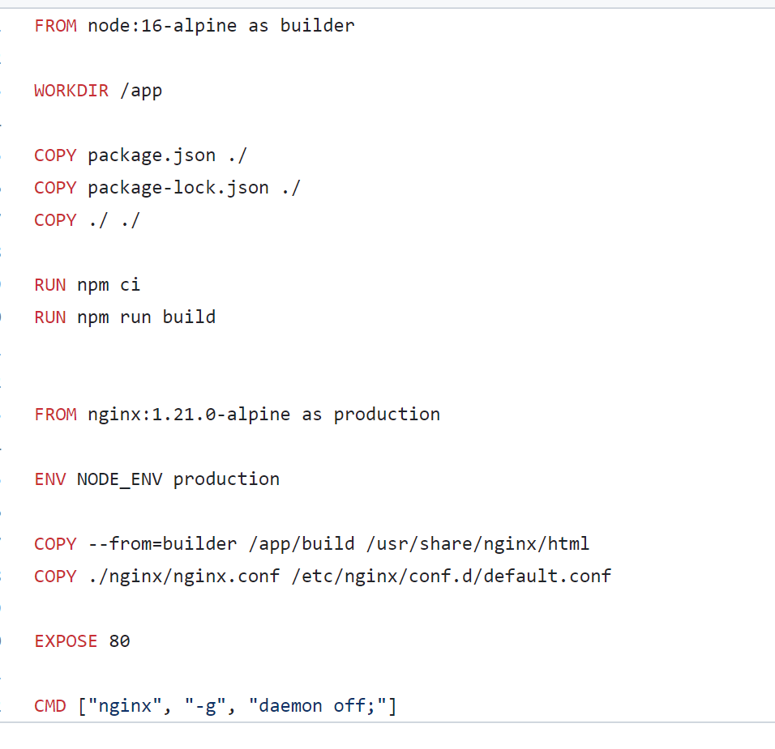
All Ground Up
Mateen Ali, Alejandro Almaraz, Jessica Arriaga,
Jett Canavarro, Steven Coffey​
Project Overview
All Ground Up is a cloud-based web application for users to order from their favorite local coffee shops. The application supports consumers, vendors, and drivers so the services can all be provided through one application. We chose to create the front-end web UI with React.js. React.js is a JavaScript development framework used for the creation of web applications.
Architecture
Database Design
The Database chosen is MySQL and it will keep track of each user, transaction, menu, etc. This will allow the web UI and worker to easily query and to post to the database.
The chart demonstrates how the different components of the project play a role in the structure of our cloud-based application.
Docker and Cloud Deployment
CI/CD Services
Web UI Dockerfile
There are three individual docker images with a backend image for Python, MYSQL image to store data and a front-end image to the run the React app. The three images were built, deployed, and managed with the Kubernetes orchestration system.
Used Jenkins to implement a continuous integration and deployment pipeline to deliver a new version of the cloud-based application. This helped to increase the development of the application by automating the software delivery while it is being built.

